Slide 1
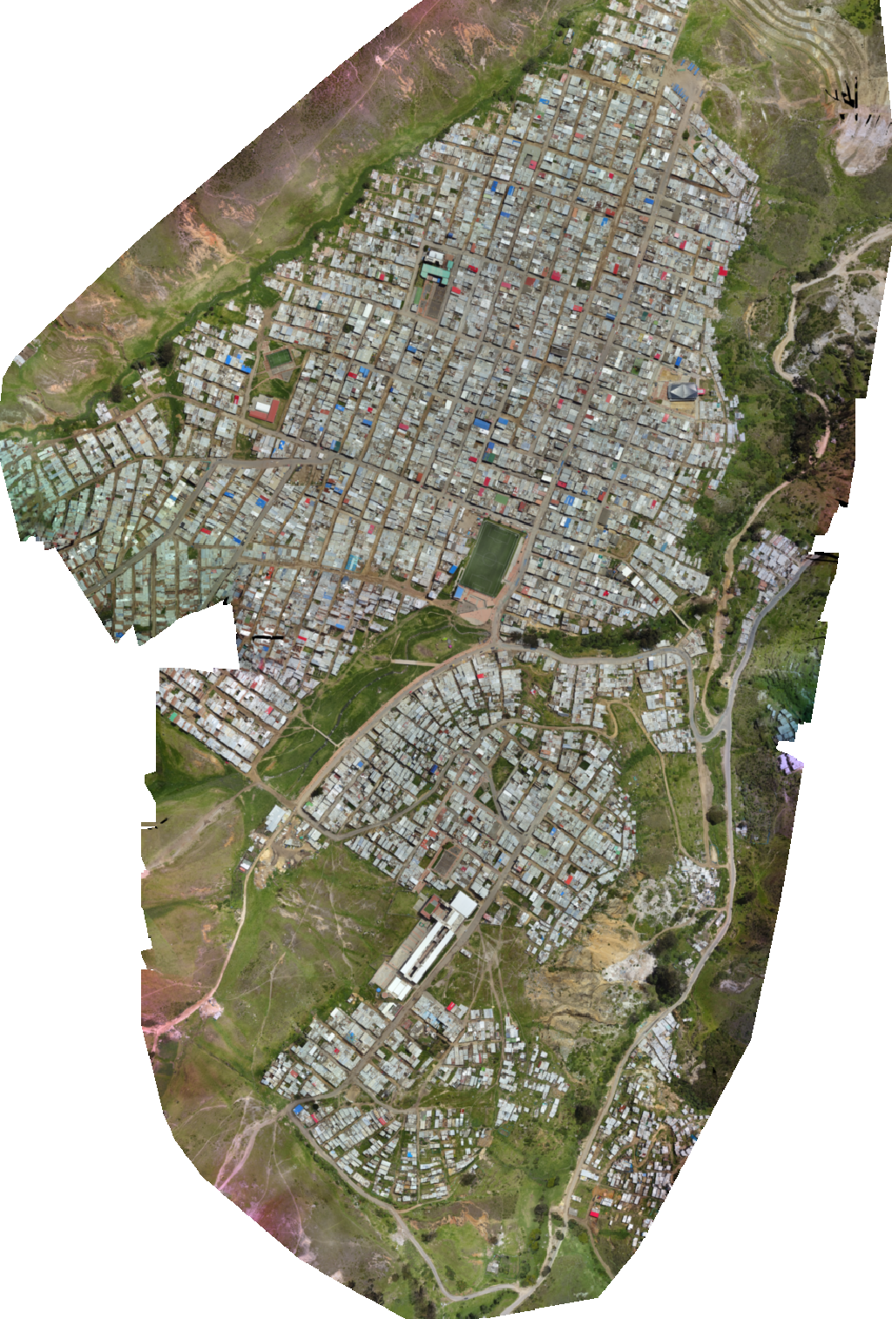
Mapping disaster risk from aerial imagery
*improving accuracy using snapshot ensembling

Slide 2



Our team
Dev Shah
Kush Aswani
Tejasva Tomar
MSDS Student
MSDS Student
MSDS Student

Slide 3
Introduction
Our goal is to use provided aerial imagery to classify the roof material of identified buildings in the Caribbean.
The traditional method for identifying high-risk buildings involves going door to door by foot, taking weeks if not months and costing millions of dollars.
If models can accurately map disaster risk from drone imagery will help drive faster, cheaper prioritization of building inspections and target resources for disaster preparation where they will have the most impact.

Slide 4
Previous state of knowledge
Manually tuning learning rate
Creating network ensembles using different architectures
Both are computationally very expensive!

Slide 5
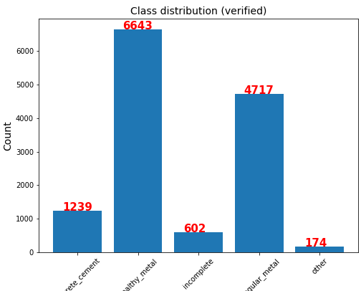
Challenges
Class Imbalance
Optimal learning rate
Network Ensembles

Slide 6
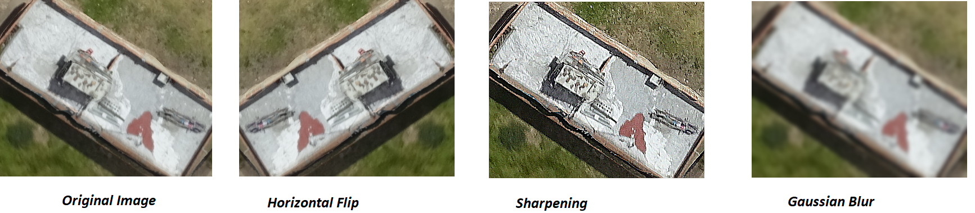
Data augmentation
To balance classes, we used various data augmentation methods including random crops, rotations,
adding noise (to make more robust classifiers), etc.
* We are implementing a GAN to generate synthetic data but it takes very long to train

Slide 7
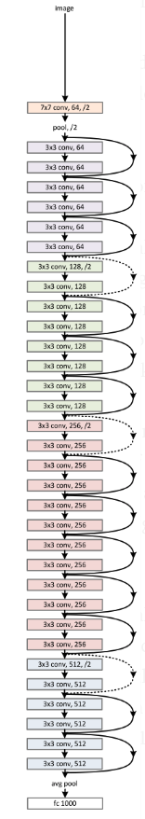
ResNet Architecture
This image shows the ResNet architecture with 34 layers residual

Slide 8
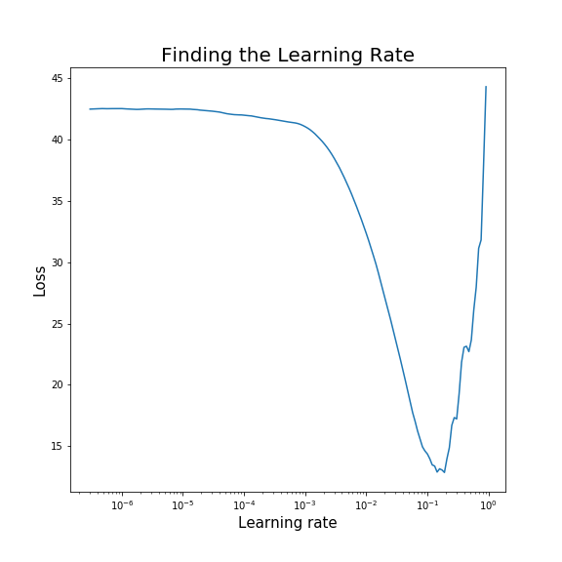
Finding the optimal learning rate
Learning Rate Range Test
Learning rate is gradually increased exponentially between 2 boundaries
Low initial learning rate allows the network to start converging whereas very high learning rates will cause the network to diverge.
Good static learning rate lr = 0.055
Cyclical learning rate = 0.1 to 0.001

Slide 9
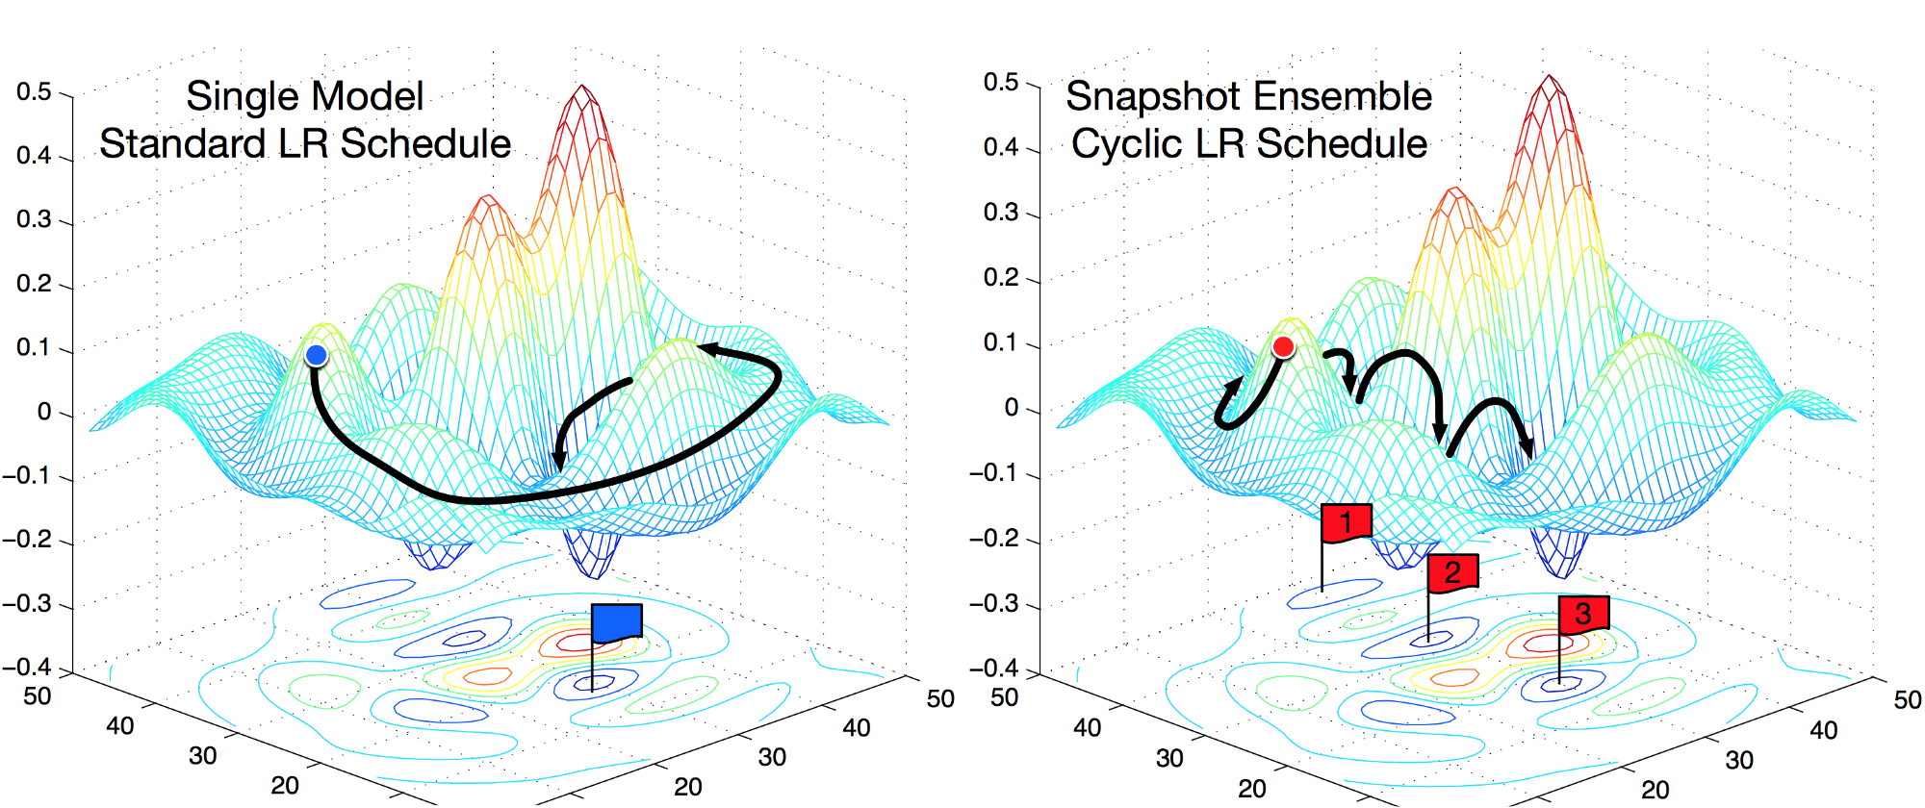
Snapshot Ensembling: Train 1, Get M!

Slide 10
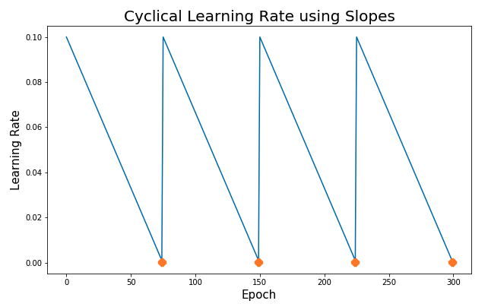
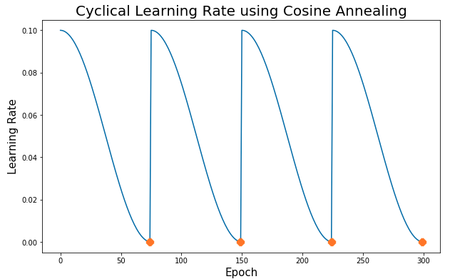
Snapshot Ensembling: Train 1, Get M!
Use a cyclical learning rate with cosine annealing
Create a snapshot of the model trained at epoch 49, 99, 149 etc.
Sudden change in learning rate after every cycle causes loss function to jump out of local minima and converge into some another minima
In this way, in a single training run, we get M different models !

Slide 11
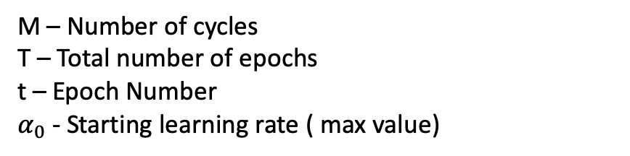
Cyclical Cosine Annealing
M – Number of cycles
T – Total number of epochs
t – Epoch Number
$α_{0}$ - Starting learning rate ( max value)

Slide 12
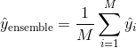
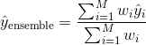
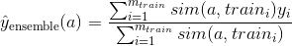
Methods to ensemble
Normal Sum average
Weighted average*
Locally weighted
* Calculating the weights using separate validation set

Slide 13
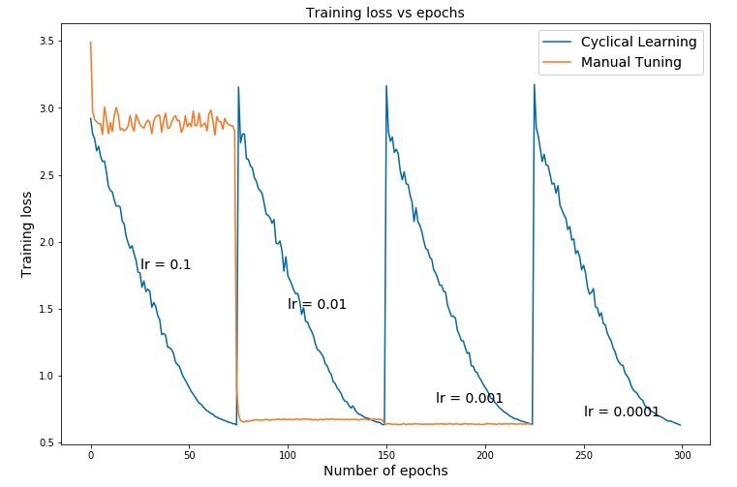
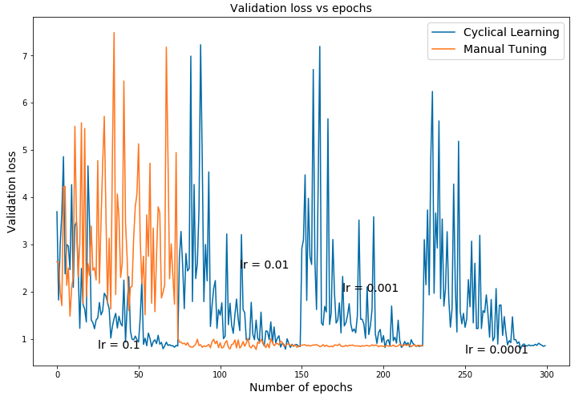
Train and Validation Loss SGD
*Linear cycles

Slide 14
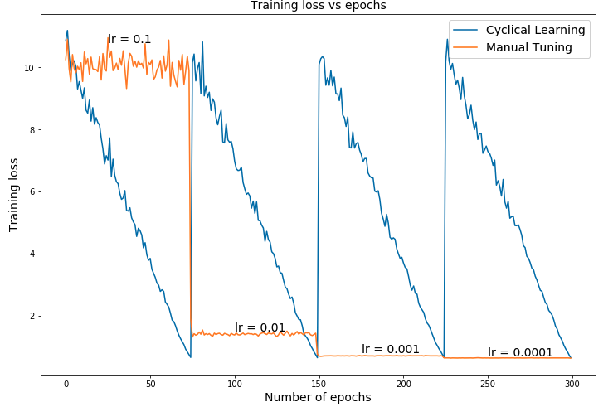
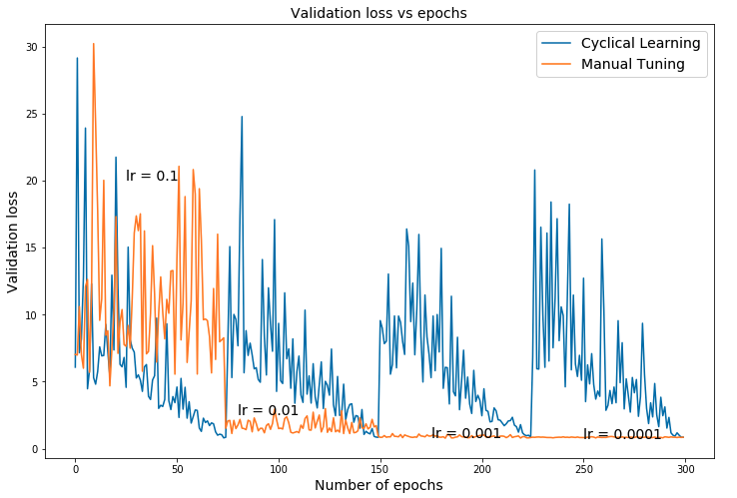
Train and Validation Loss ADAM
*Linear cycles

Slide 15
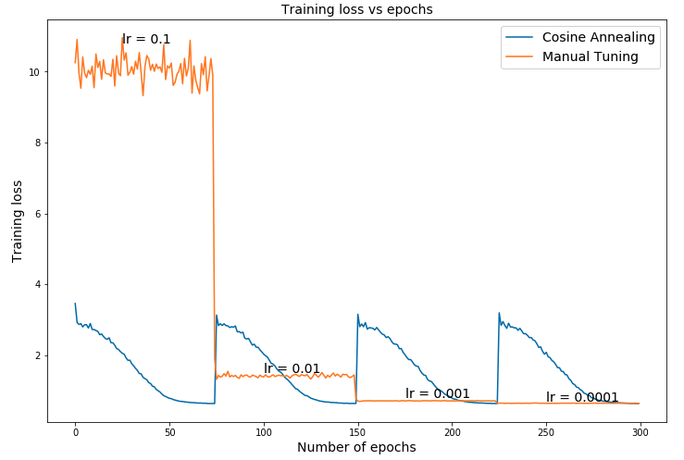
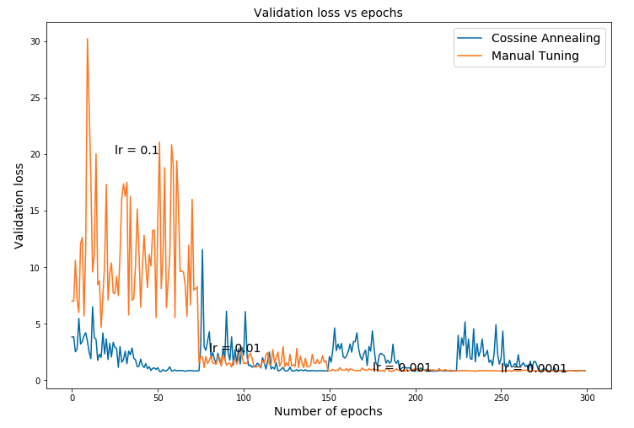
Train and Validation Loss SGD
*Cosine Annealing

Slide 16
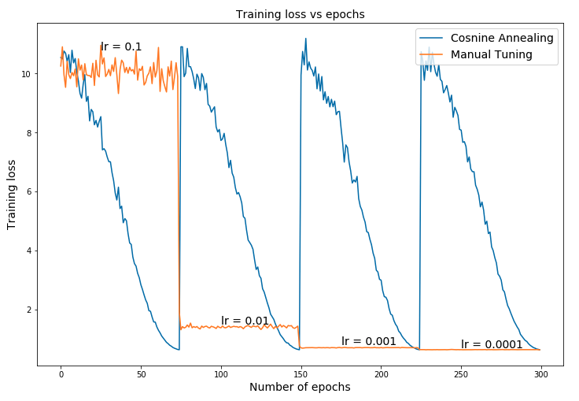
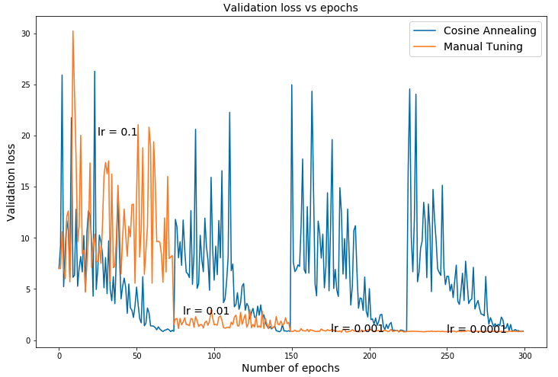
Train and Validation Loss Adam
*Cosine Annealing

Slide 17
Evaluation
Multi class classification problem : Categorical Cross Entropy
Manual Tuning
 | Adam | SGD
ResNet50 | 0.8551 | 0.8634
Cyclical Learning
Model | Optimizer | Simple Average | Weighted average
ResNet50 with linear cycles | Adam | 0.8355 | 0.8329
 | SGD | 0.8476 | 0.8416
ResNet50 with cosine annealing | Adam | 0.8618 | 0.8550
 | SGD | 0.8439 | 0.8365

Slide 18
Conclusion
Learning Rate Range Test is an efficient way to find a good static learning rate for a model.
Snapshot Ensembling performs better as compared to manually tuning the learning rate parameter using the same computational resources.
Better generalization ability as compared to a single model due to ensembling.
Our solution is currently ranked 61 out of 1200 teams

